Slide 1
Module 14: Building Native Code
SER 423

Slide 2
About Native Code
We’ve talked a lot about how react is an abstraction of both native languages to provide a cross platform solution
This was particularly important when looking at using plugins
What we’ve been making are called hybrid apps
  That is, they can run on either platform
The problem again is what if we want functionality that we can’t access in react
To get to that functionality we will need to build an app that has at least some native implementation
  This is the primary reason to do anything in native code
Because they use different APIs, we will need to use different native functions for Android VS iOS

Slide 3
Using Native Code from JavaScript
The apps we’re building are called hybrid apps, both because they can be exported to both platforms, but the flipside of that is that they run both JavaScript and native code
  Remember the two threads and the bridge from the performance module?
You will usually still use react for your UI
  That’s what react is built for!
It is for back end functionality that you dip into native code
You can import native functions into your JavaScript files by importing NativeModules from react-native
This then gives you a simple object to work with that allows you to call the native functions
  This is the bridge between the threads

Slide 4
Native Android

Slide 5
Writing Android Functions
Native Android functions are written in Java, not JavaScript
  Kotlin might take over this soon, but for now it is compiled into native in order to be run
You’ll need to create your app as a pure react app, or eject it
This gives you an Android folder and the native code needs to go in there
You will first want to define your class, which needs to extend ReactContextBaseJavaModule
This has a getName method you need to override
  This name is how this function will be identified in react
After implementing this and your functions, we have to register the module with the app
You’ll need a class that implements the ReactPackage interface and adds your module to the list
Finally, you need to update MainApplication to take your new package

Slide 6
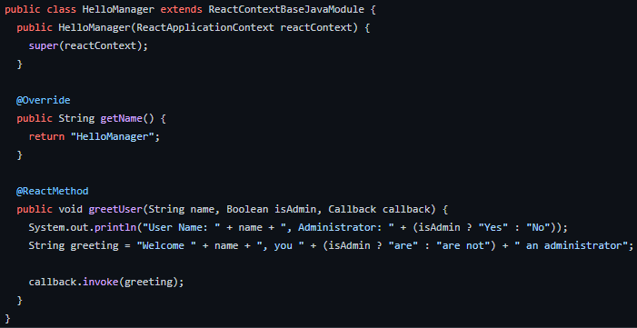
Example Native Function

Slide 7
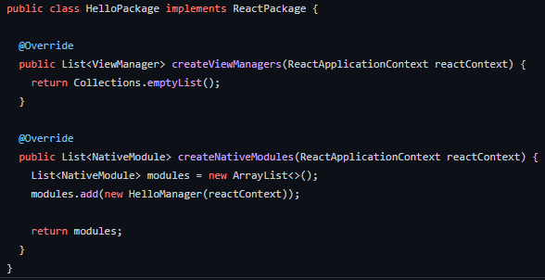
Creating the Example Package

Slide 8
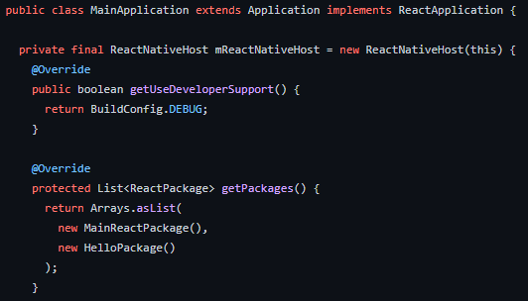
Registering the Package

Slide 9
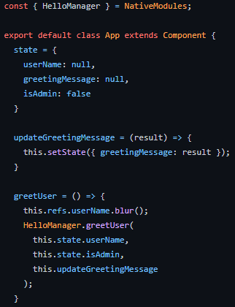
Using This Module in React

Slide 10
Native iOS

Slide 11
Writing iOS Functions
iOS native code is typically written in Swift
  You could use Objective-C, if you’re brave. Some react implementations are abstractions of Objective-C
However, the book example is in Objective-C and it is still used frequently
  Using Swift will actually create an Objective-C header file to allow the class to be accessed by both languages
  Using Swift technically still uses Objective-C, but you can use Swift as your primary language
When you create a new Objective-C class, you will get both a header and an implementation (.m) file
The header file is where we’ll need to import the bridge
The implementation file is obviously where we implement our functionality
It is also where we register it with the react bridge

Slide 12
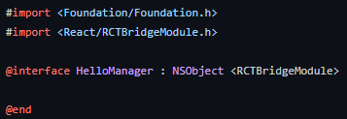
Header File

Slide 13
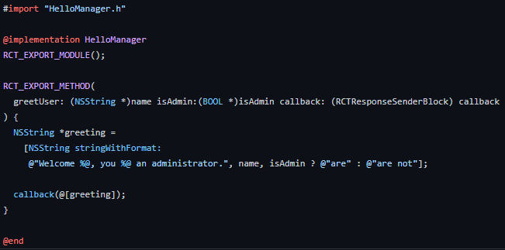
Implementation File

Slide 14
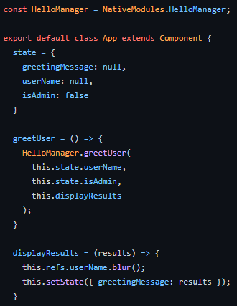
Usage in React

Slide 15
Final Thoughts
Remember that the native thread is much faster than the JavaScript one
Also remember that the bridge is the bottleneck, minimize what you pass across it
This means two things:
  Only use native code for heavy lifting tasks for the back end
  Keep your UI and front end in JavaScript
You probably want a pure react native app
  Or eject it first
Android and iOS apps have their own directory structure you’ll need to stick to
  iOS: appName/ios/appName/HelloManager.m
  Android: appName/android/app/src/main/java/com/appName/HelloManager.java
  Putting things in the wrong place will cause issues!

Slide 16
End of Building Native Code
That’s it for Module 14!

